Slide 1
CSC 250: Foundations of Computer Science I
Fall 2023 - Lecture 10
Amitabha Dey
Department of Computer Science
University of North Carolina at Greensboro

Slide 2
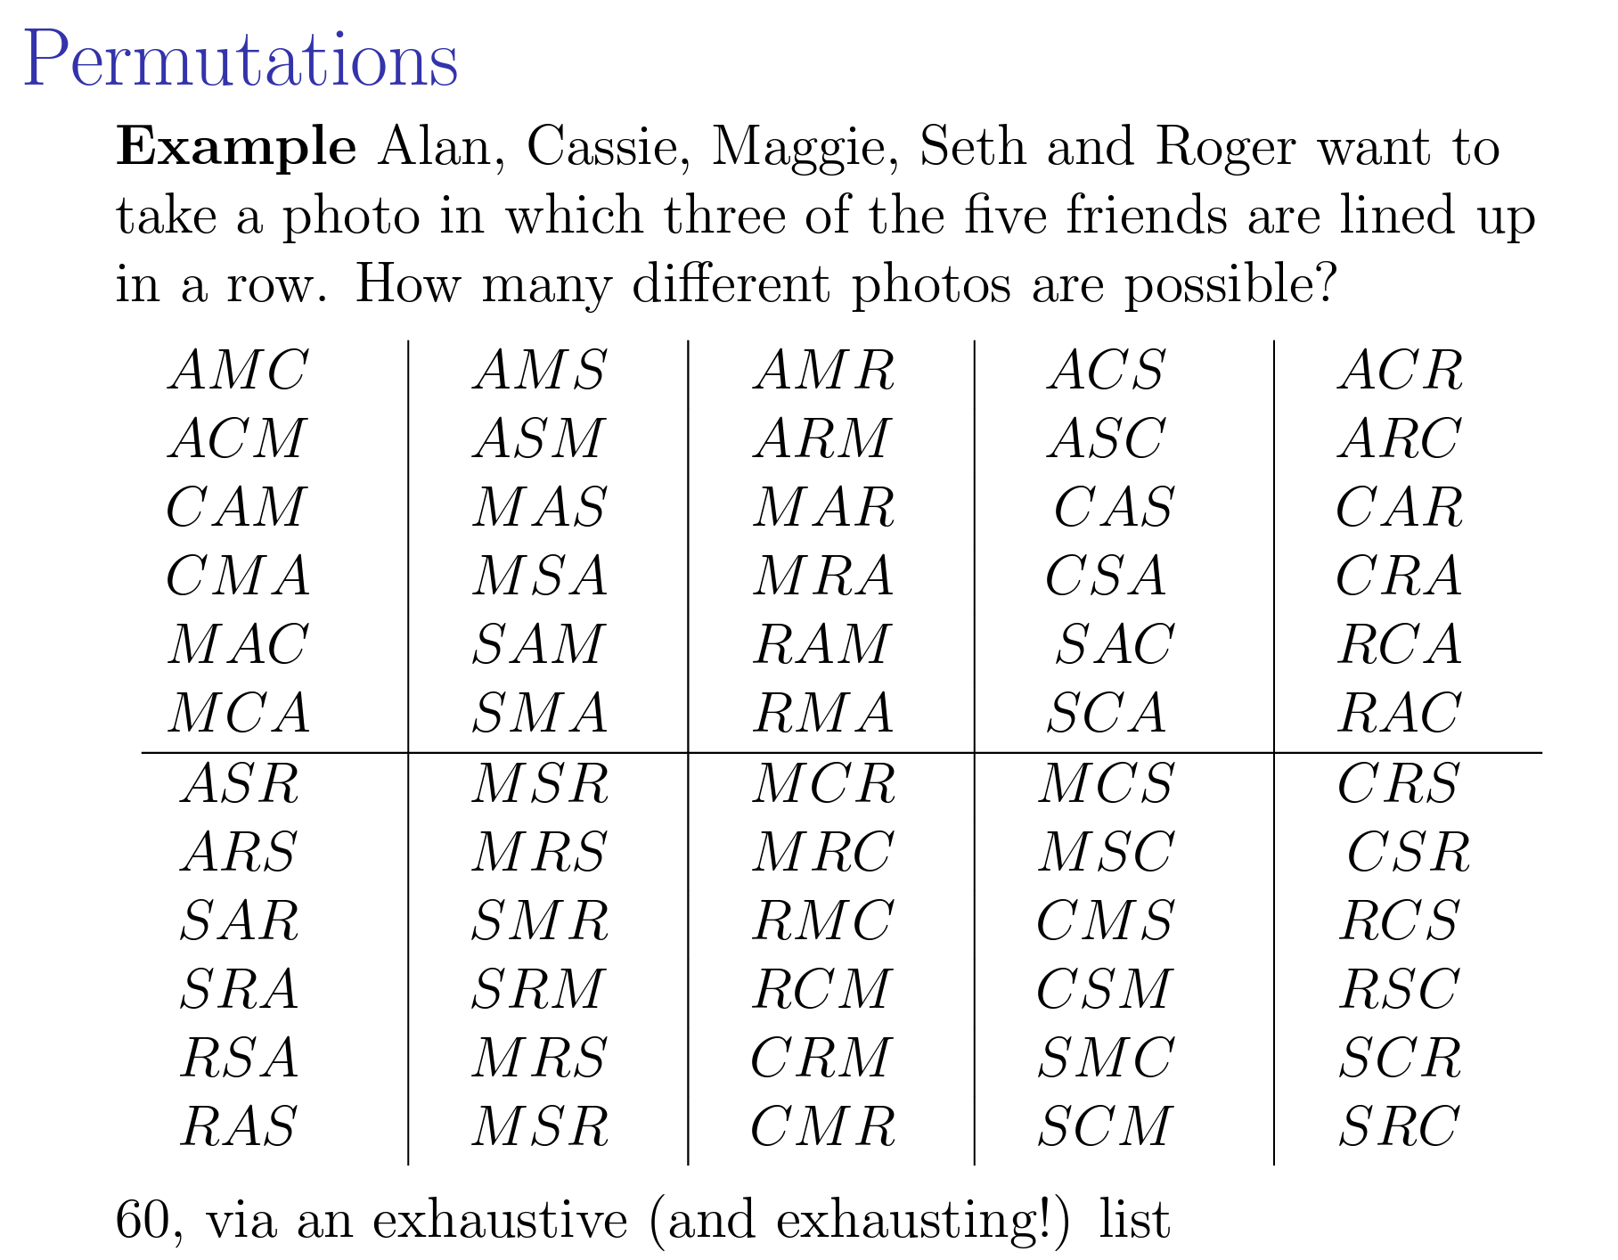
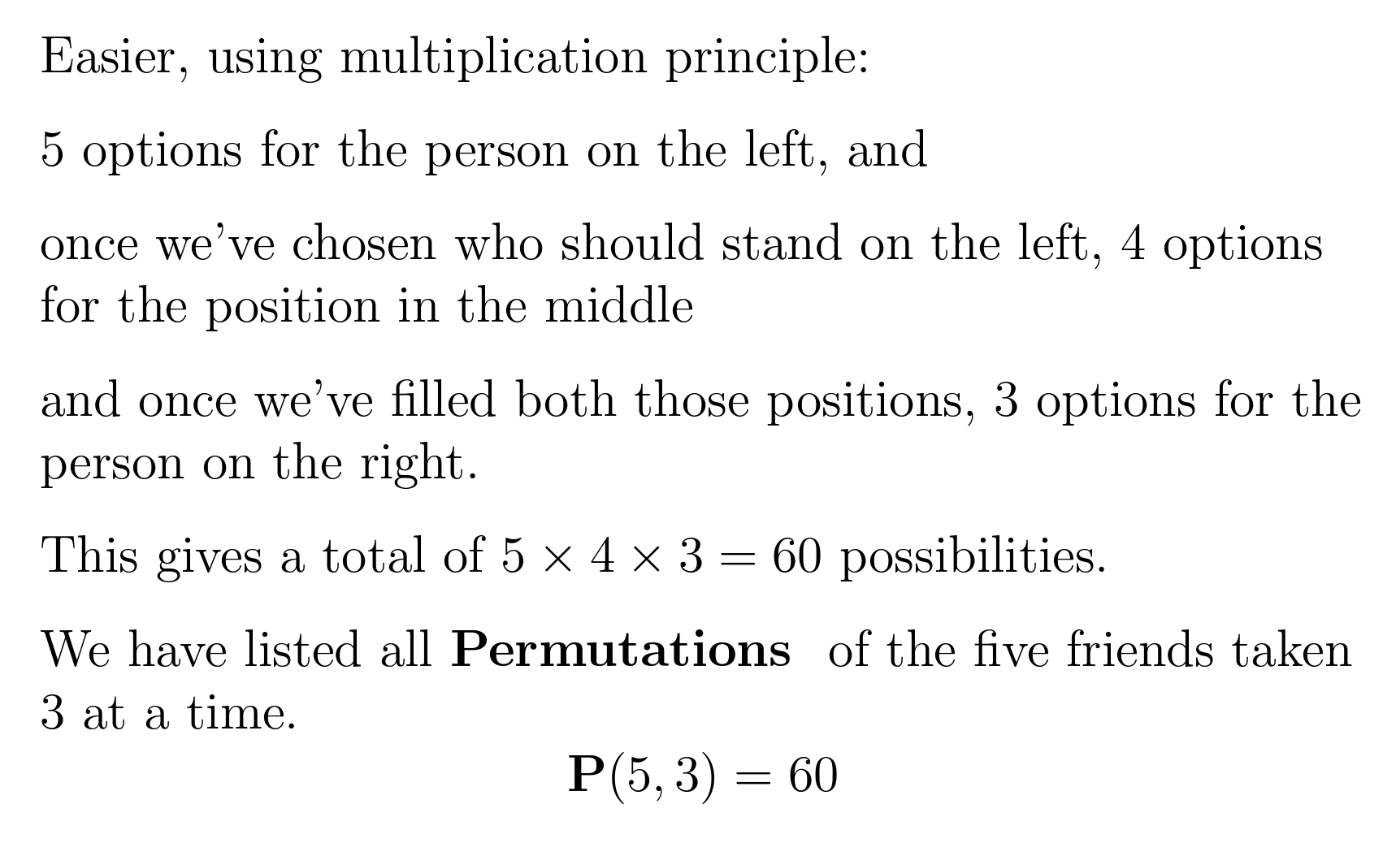
Permutations
Image credit - https://www3.nd.edu

Slide 3
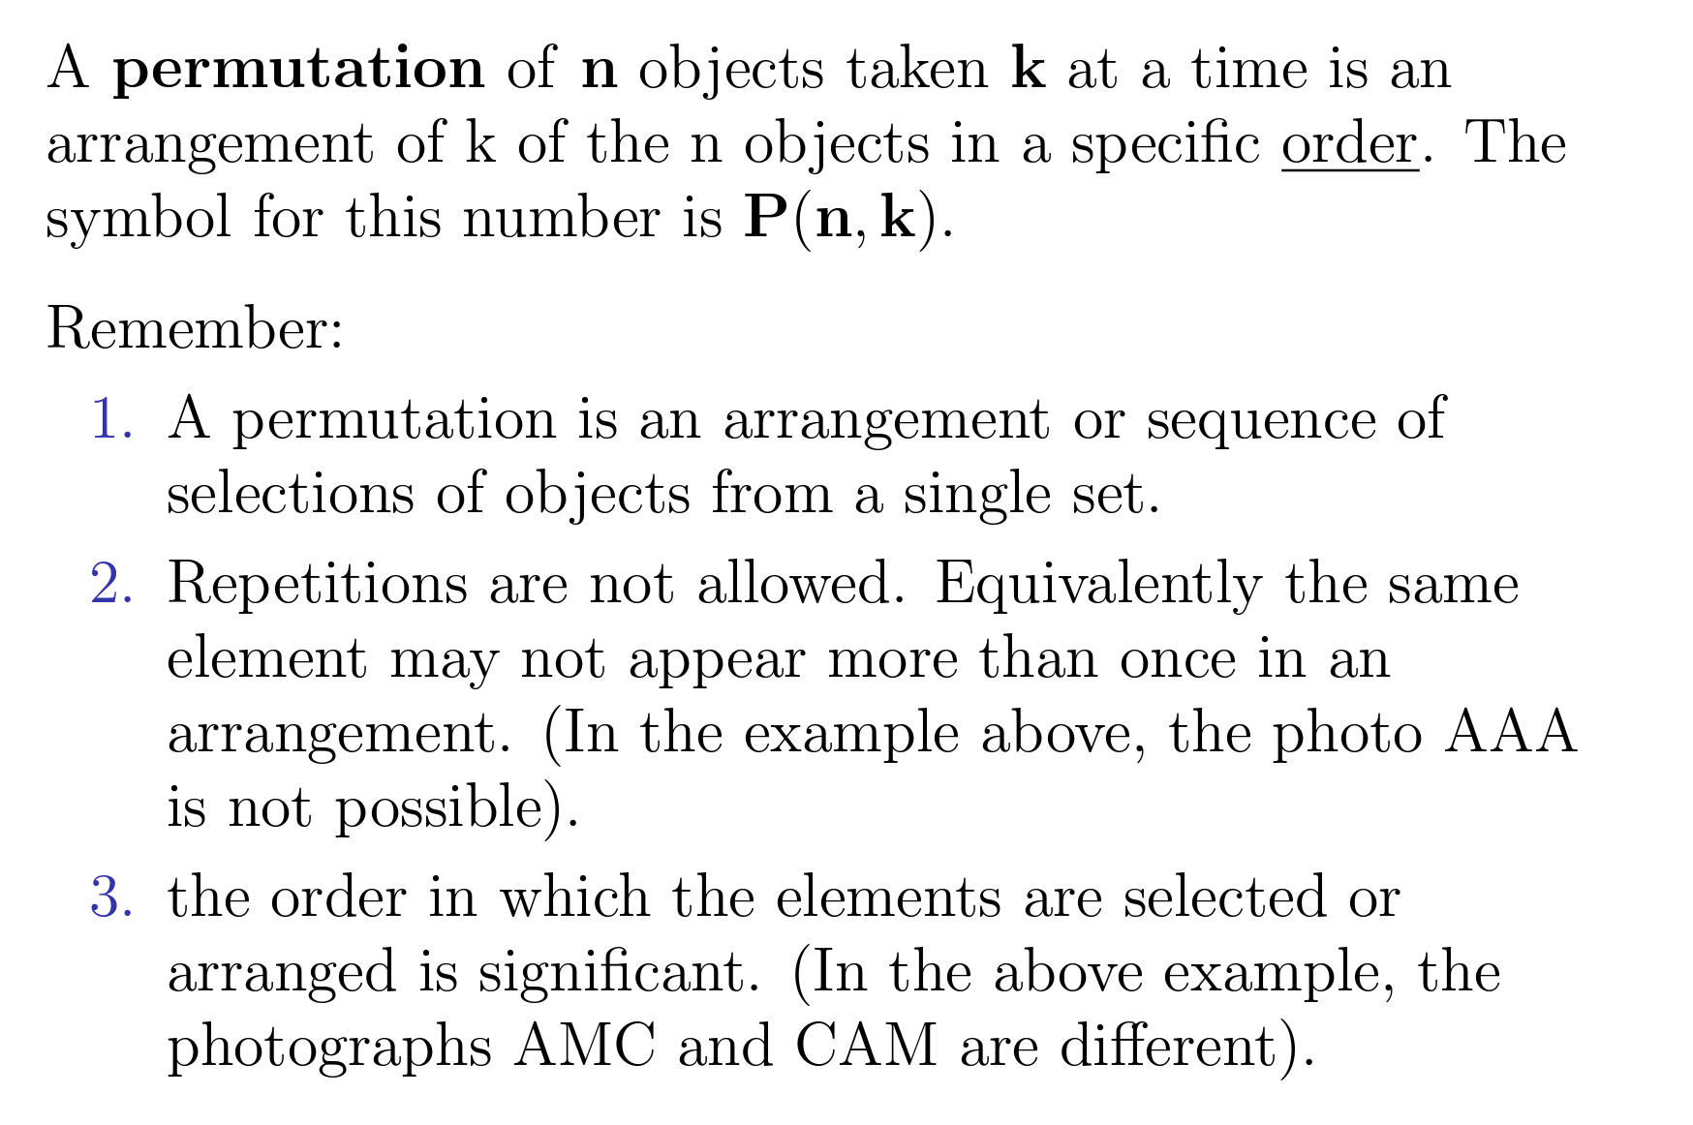
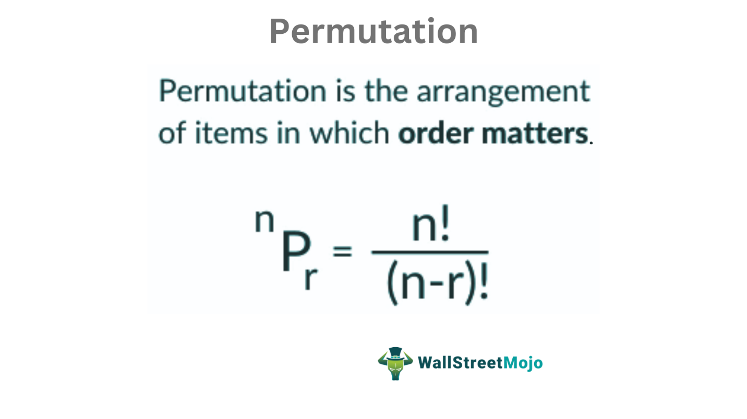
Permutations
Permutation refers to the arrangement of objects in a definite order. That means permutation is the arrangement of objects in which order matters. The arrangement of r objects out of n objects can be calculated using the permutation formula.
Image credit - https://www3.nd.edu
Image credit - https://www.wallstreetmojo.com/

Slide 4
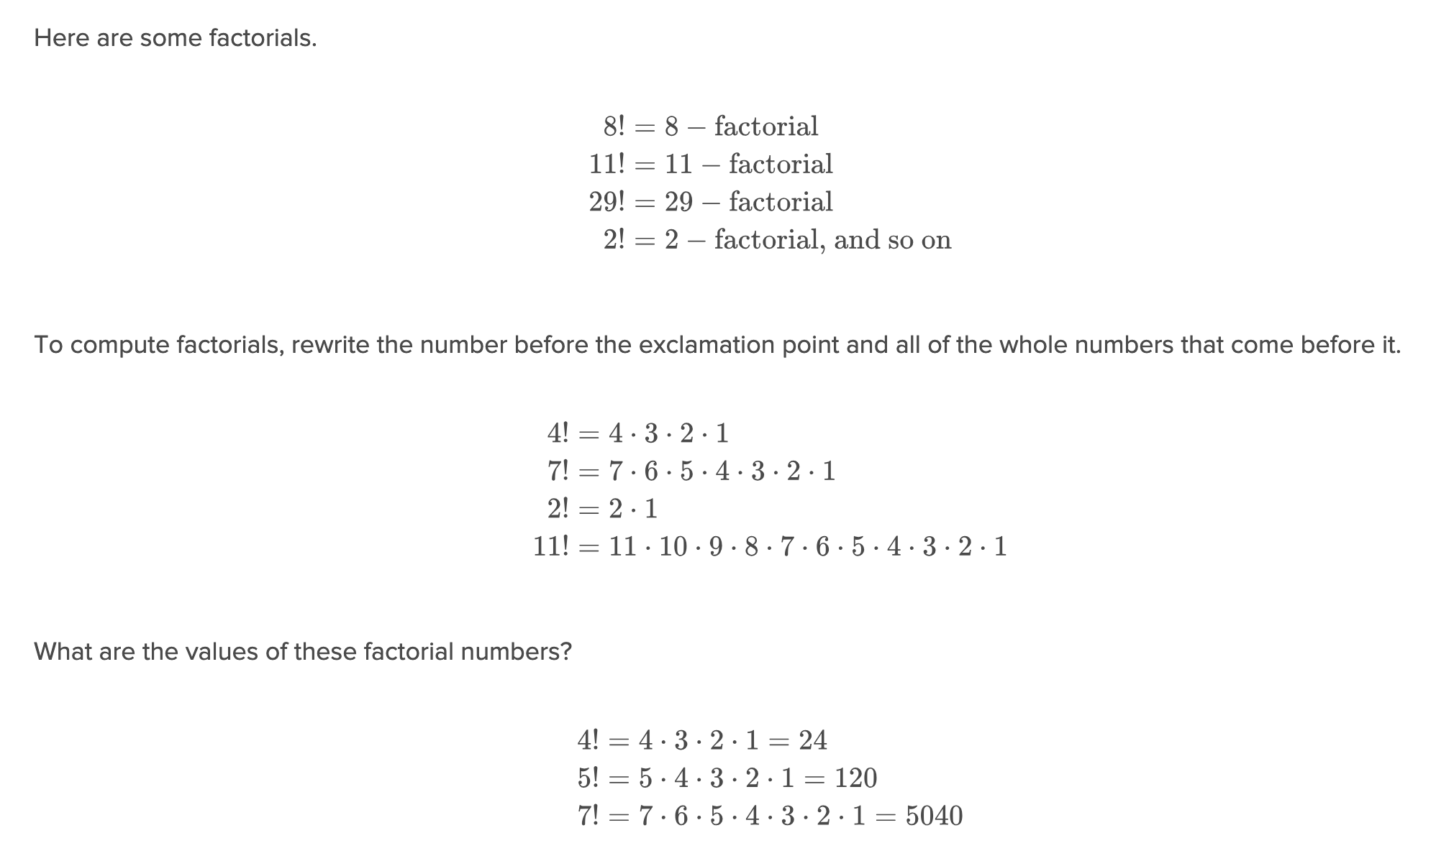
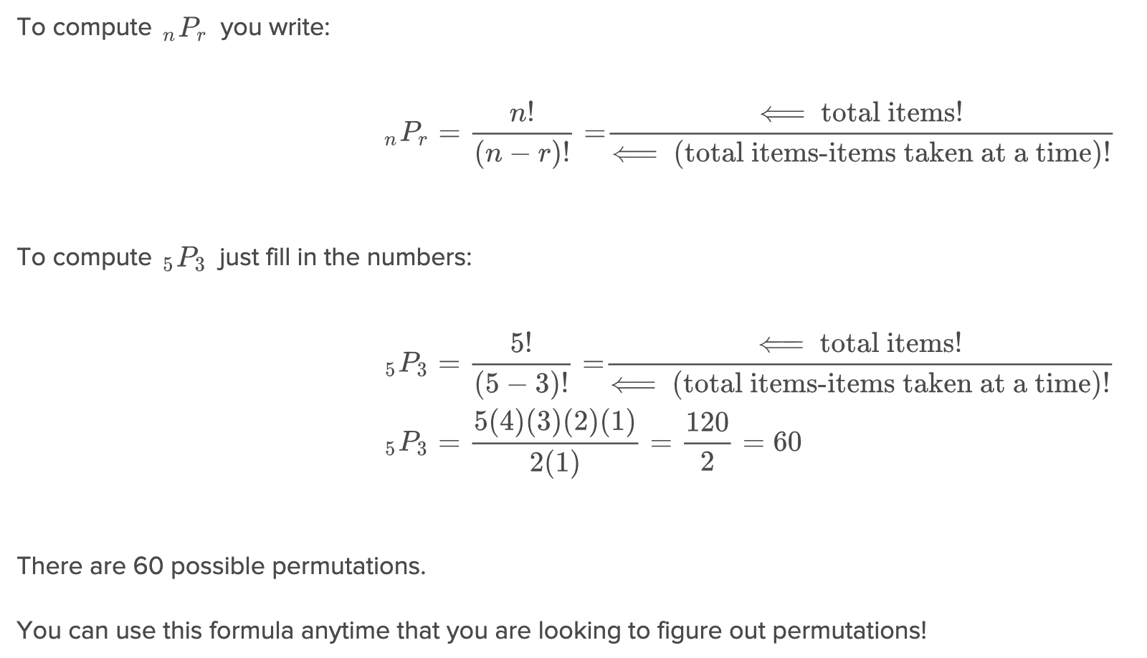
Permutations
Image credit - https://flexbooks.ck12.org/

Slide 5
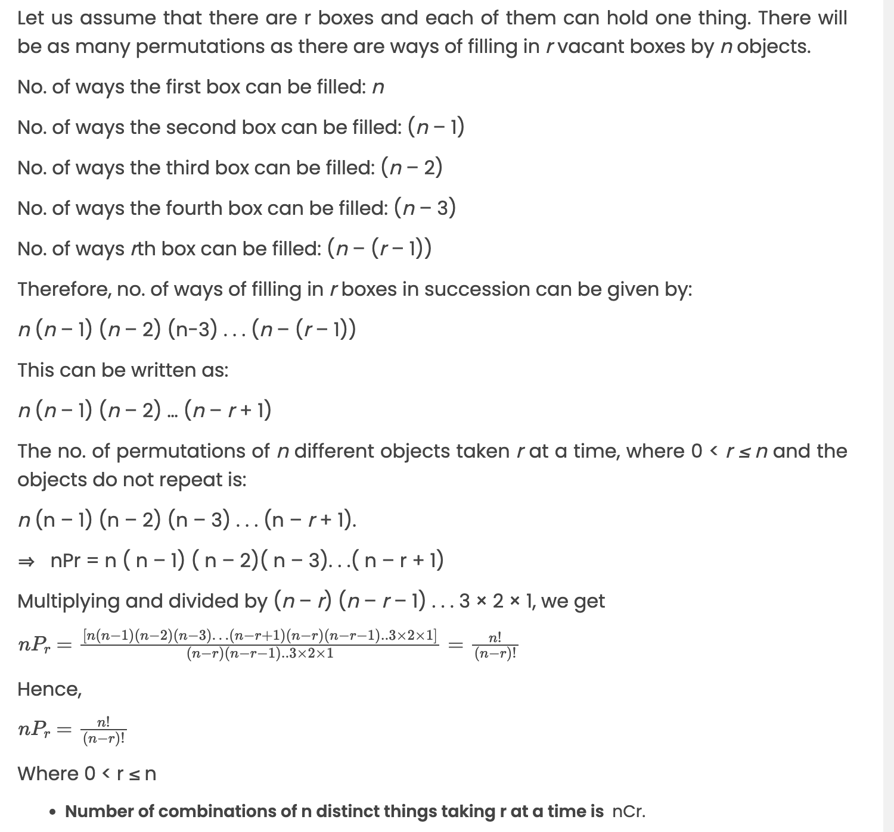
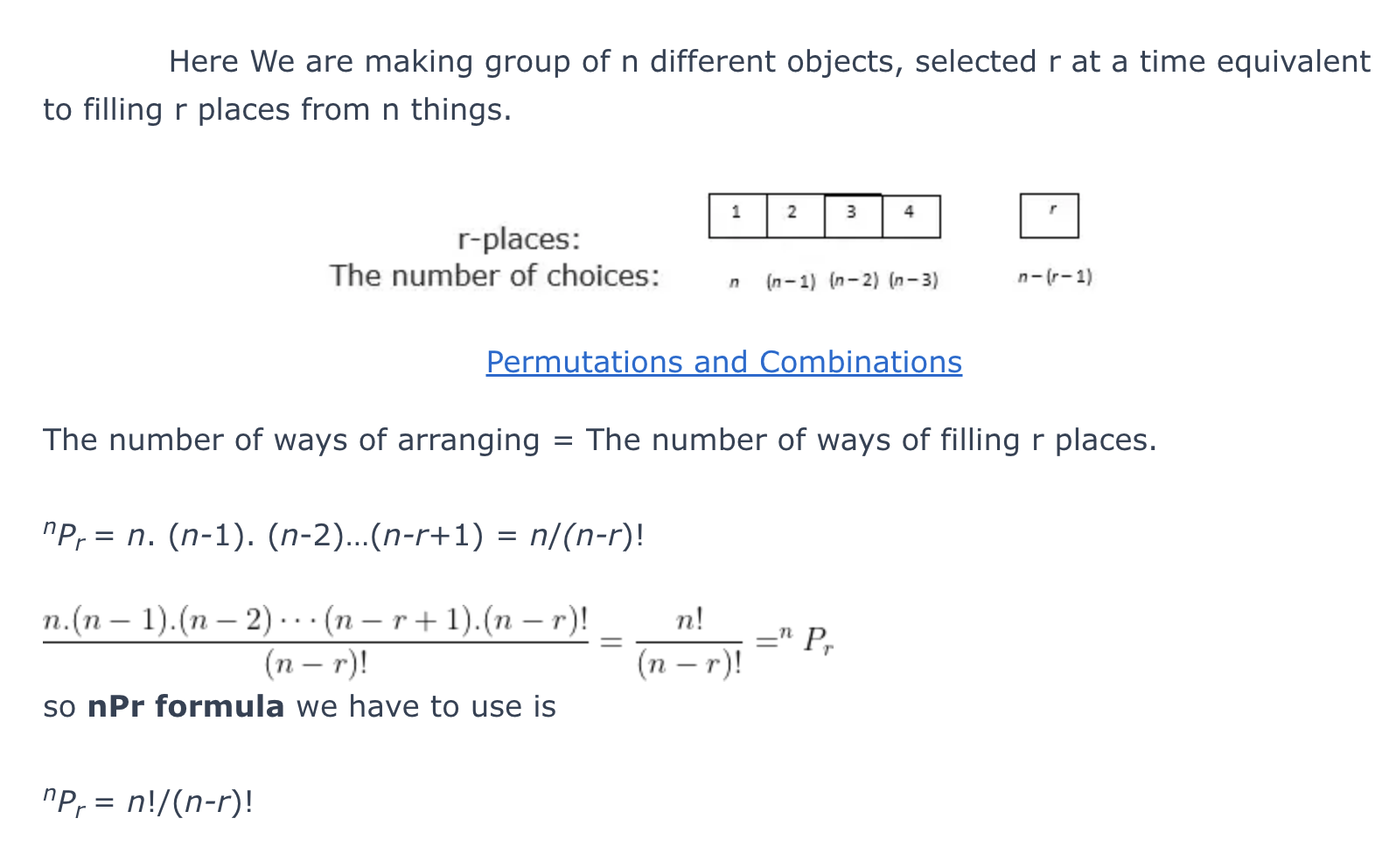
Permutations
Formula Derivation
Image credit - https://lambdageeks.com/
Image credit -https://byjus.com/

Slide 6
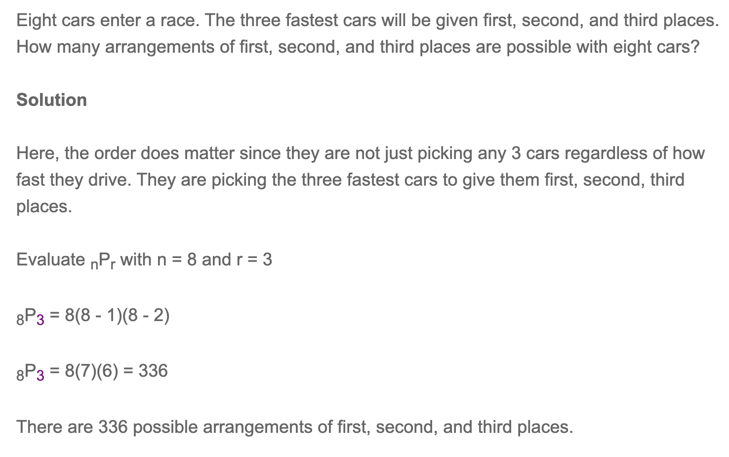
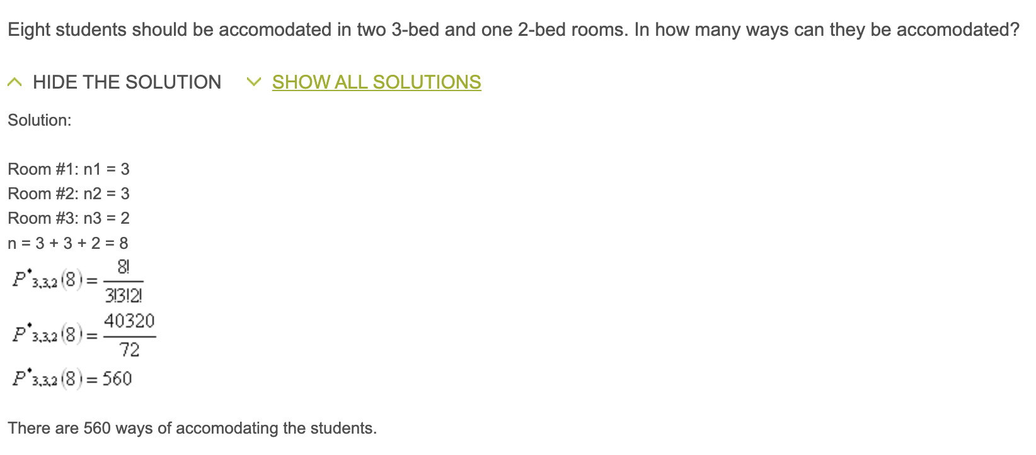
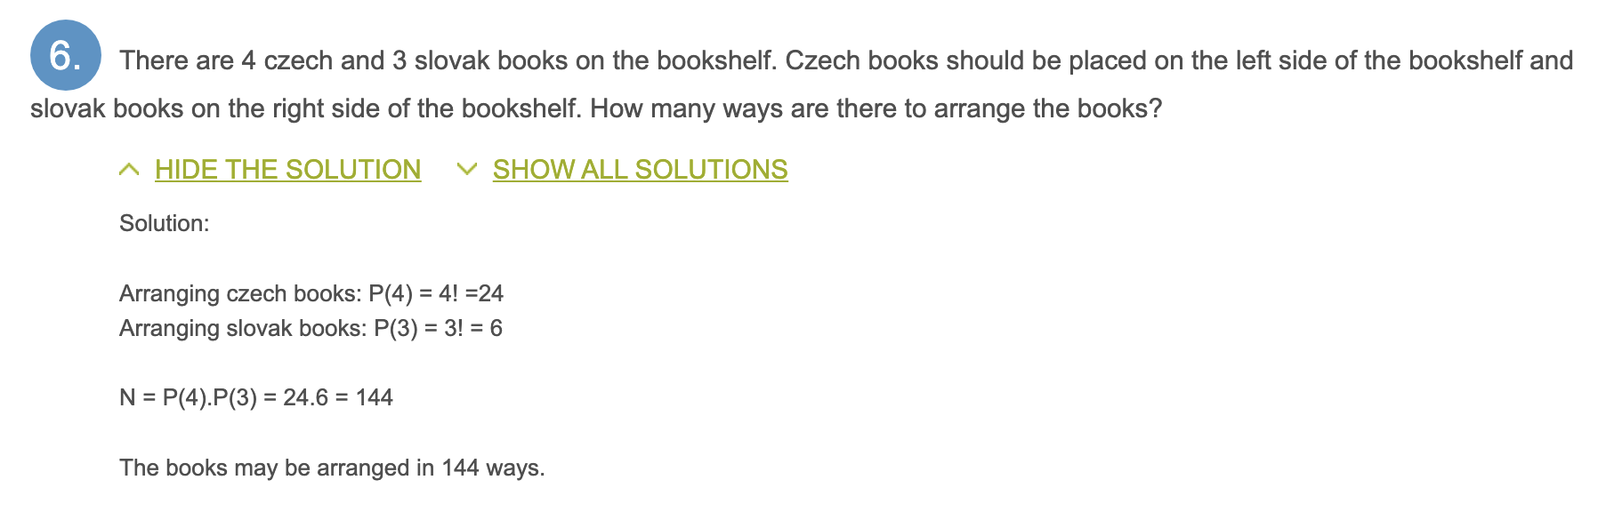
Permutations
Examples
Image credit - https://www.basic-mathematics.com/
Image credit - https://www.priklady.eu/

Slide 7
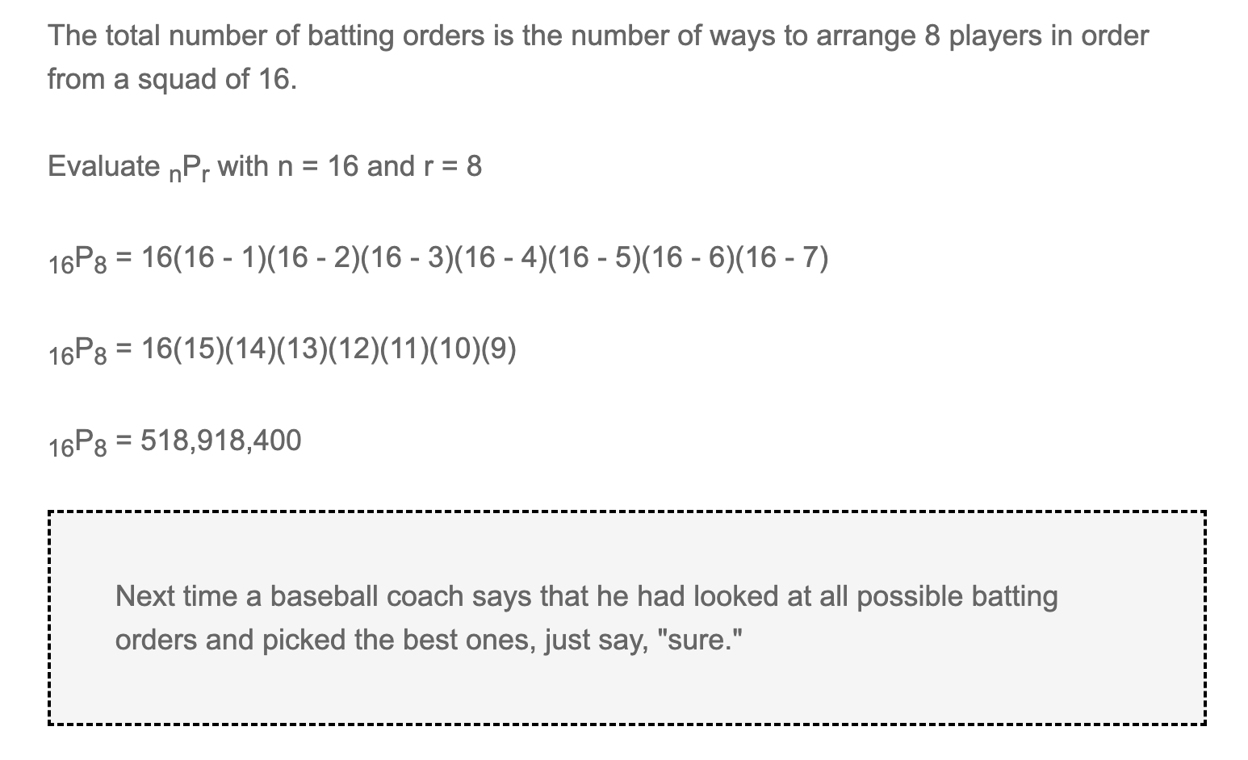
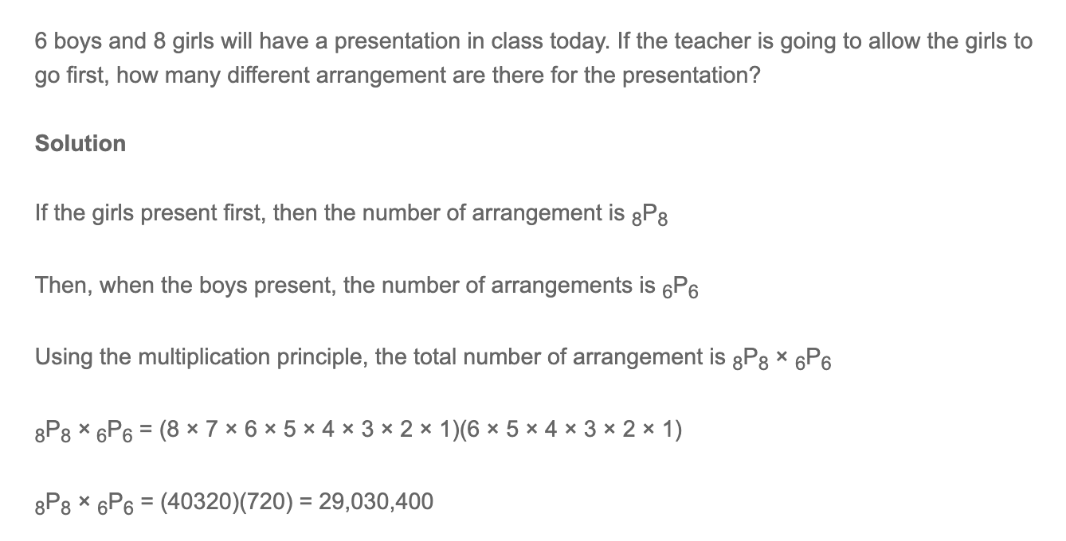
Permutations
Examples
Image credit - https://www.basic-mathematics.com/

Slide 8
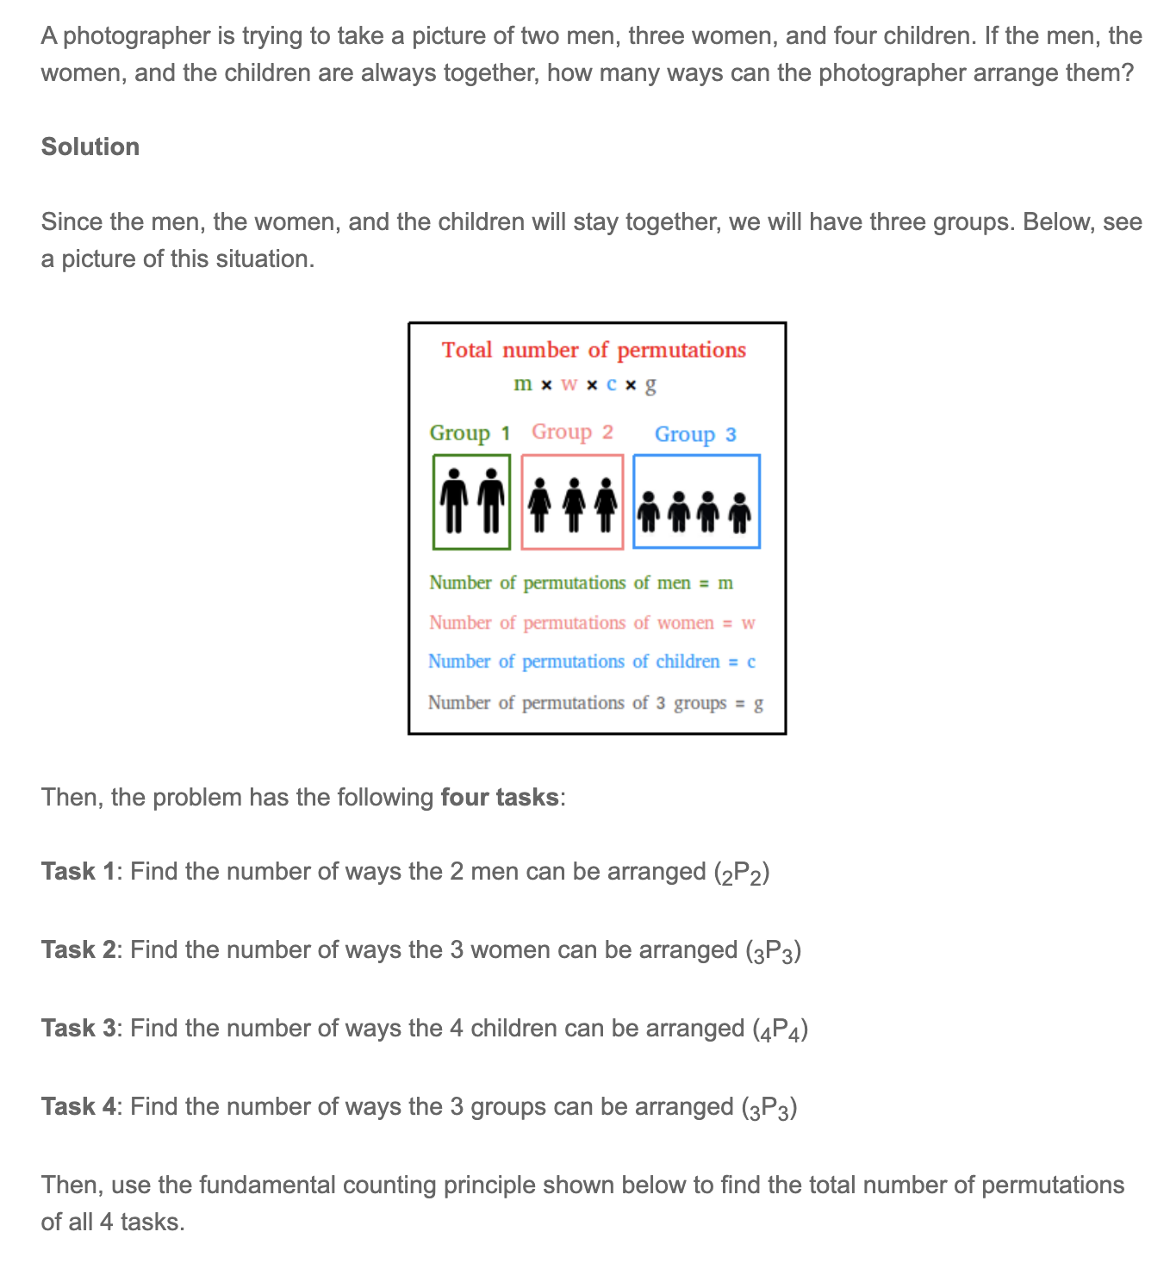
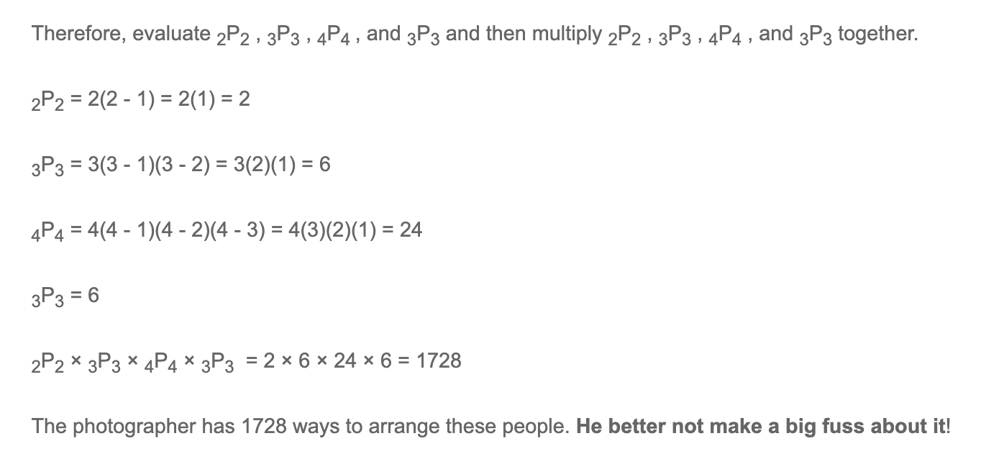
Permutations
Examples
Image credit - https://www.basic-mathematics.com/

Slide 9
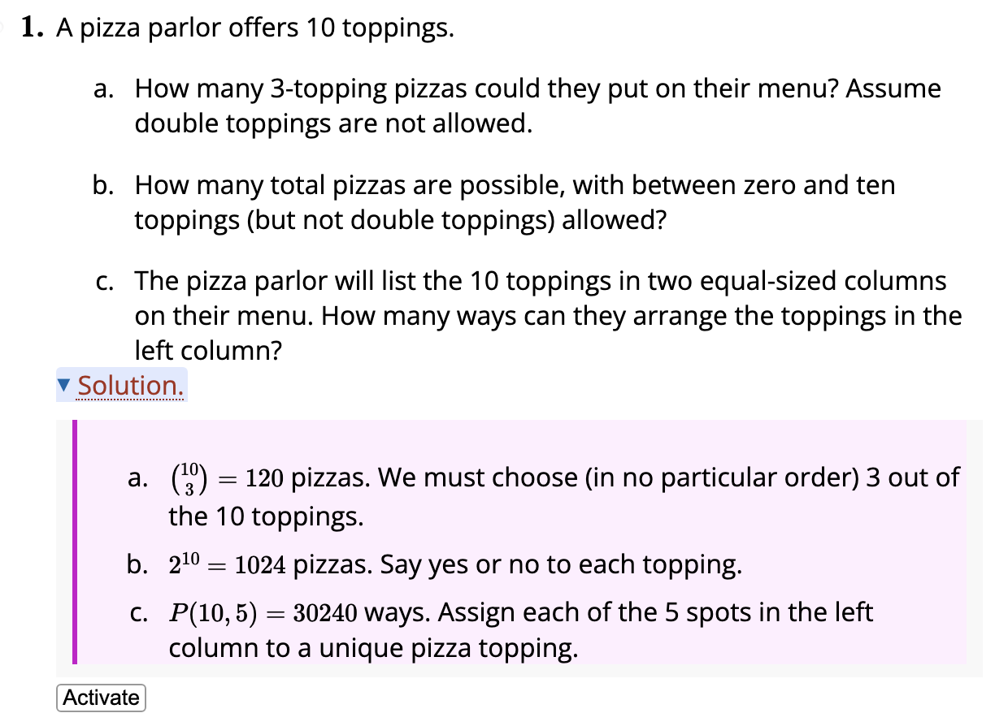
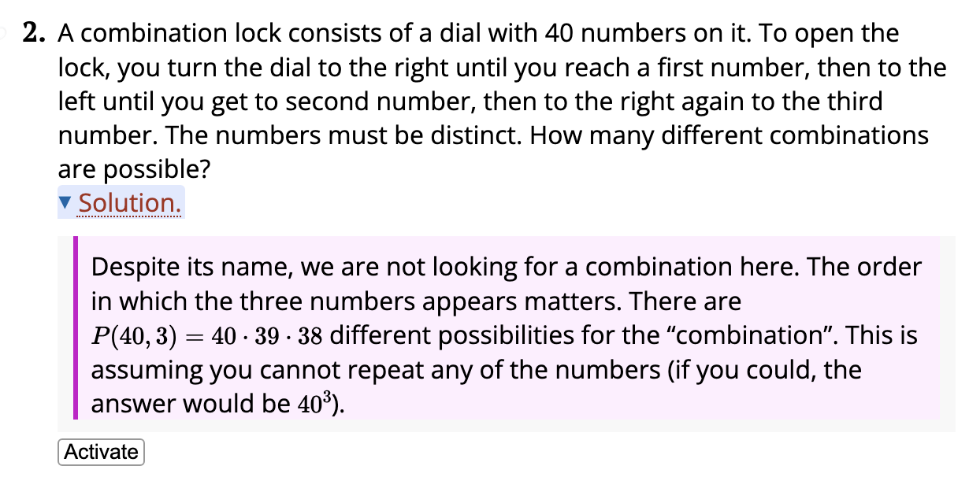
Permutations
Examples
Image credit - https://discrete.openmathbooks.org/

Slide 10
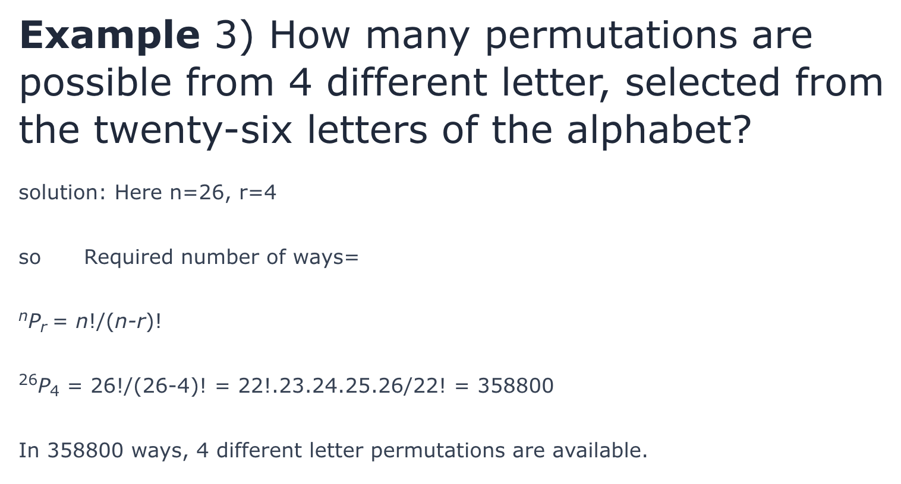
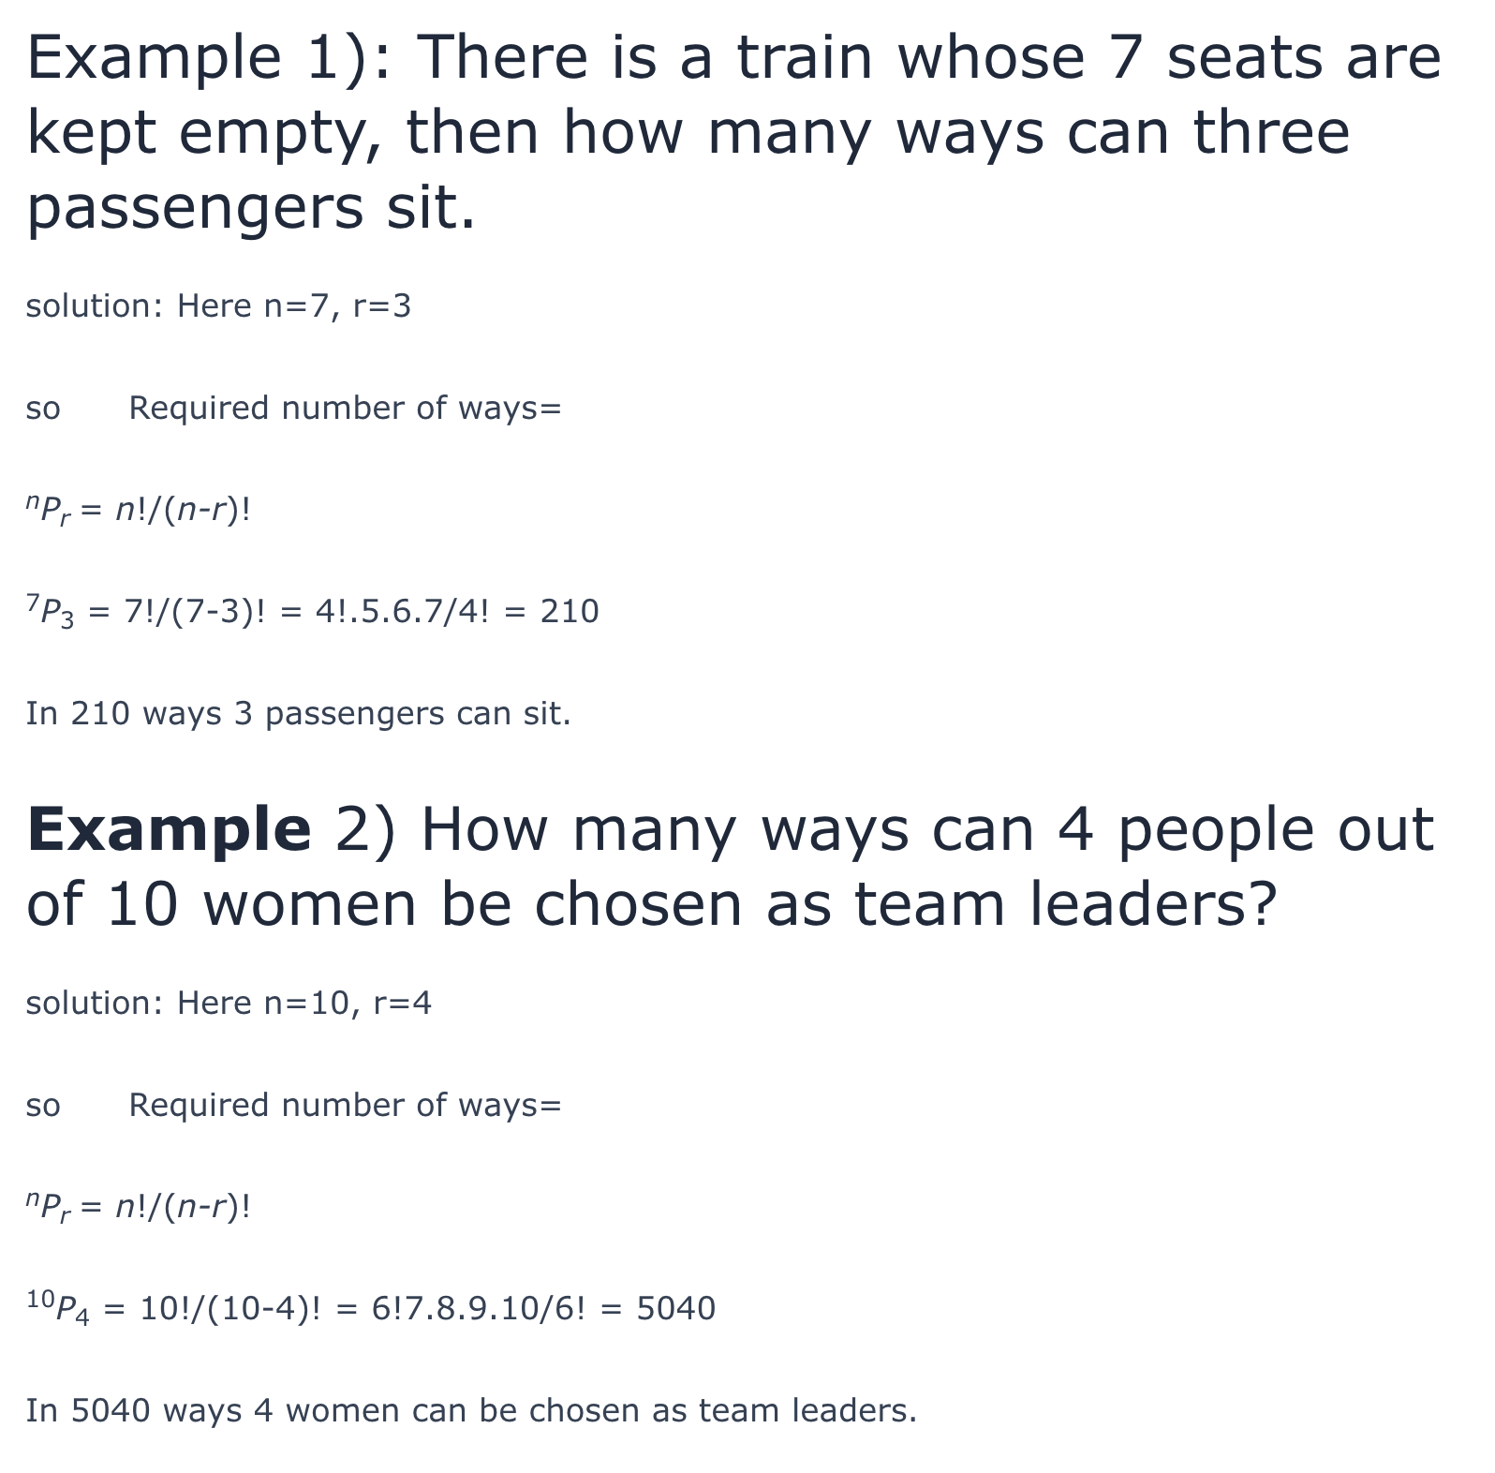
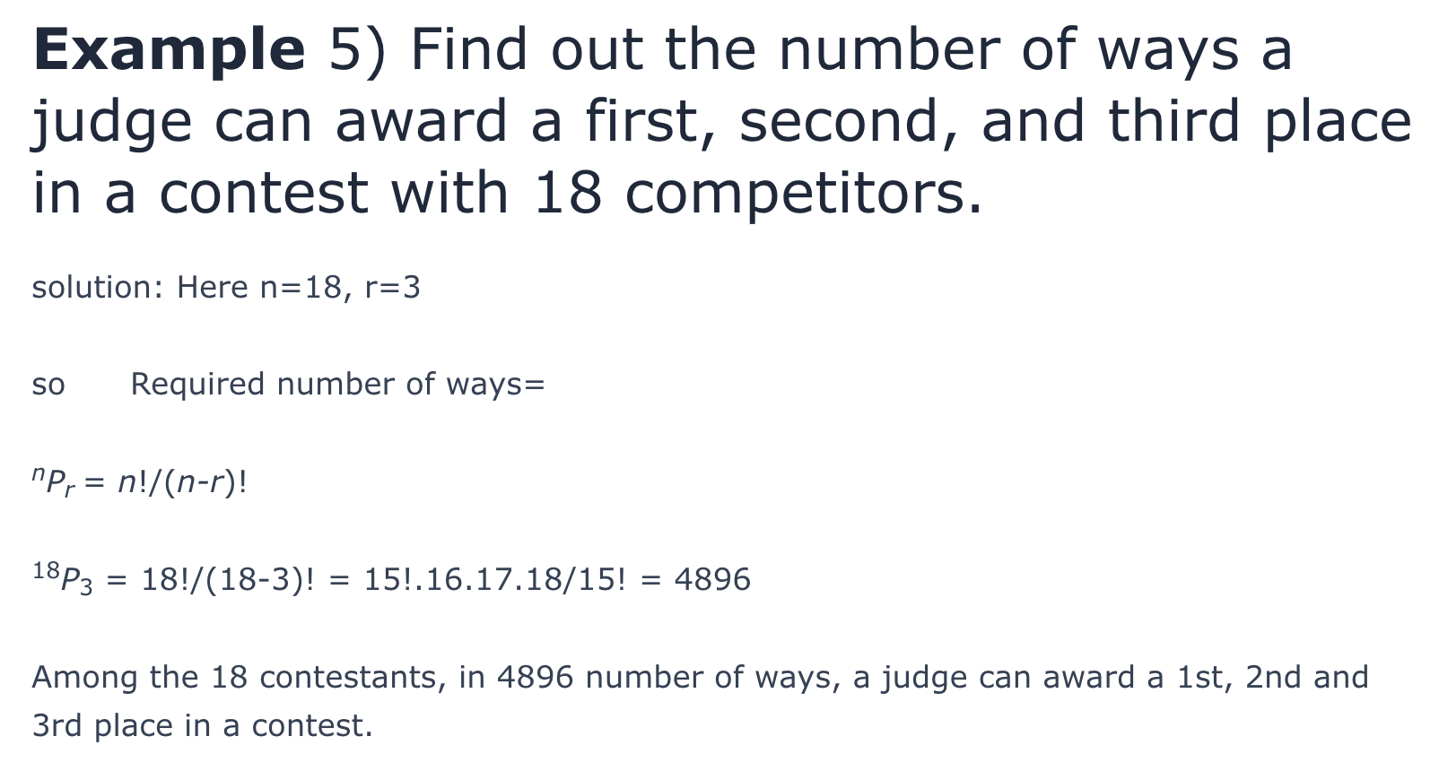
Permutations
Examples
Image credit - https://lambdageeks.com/

Slide 11
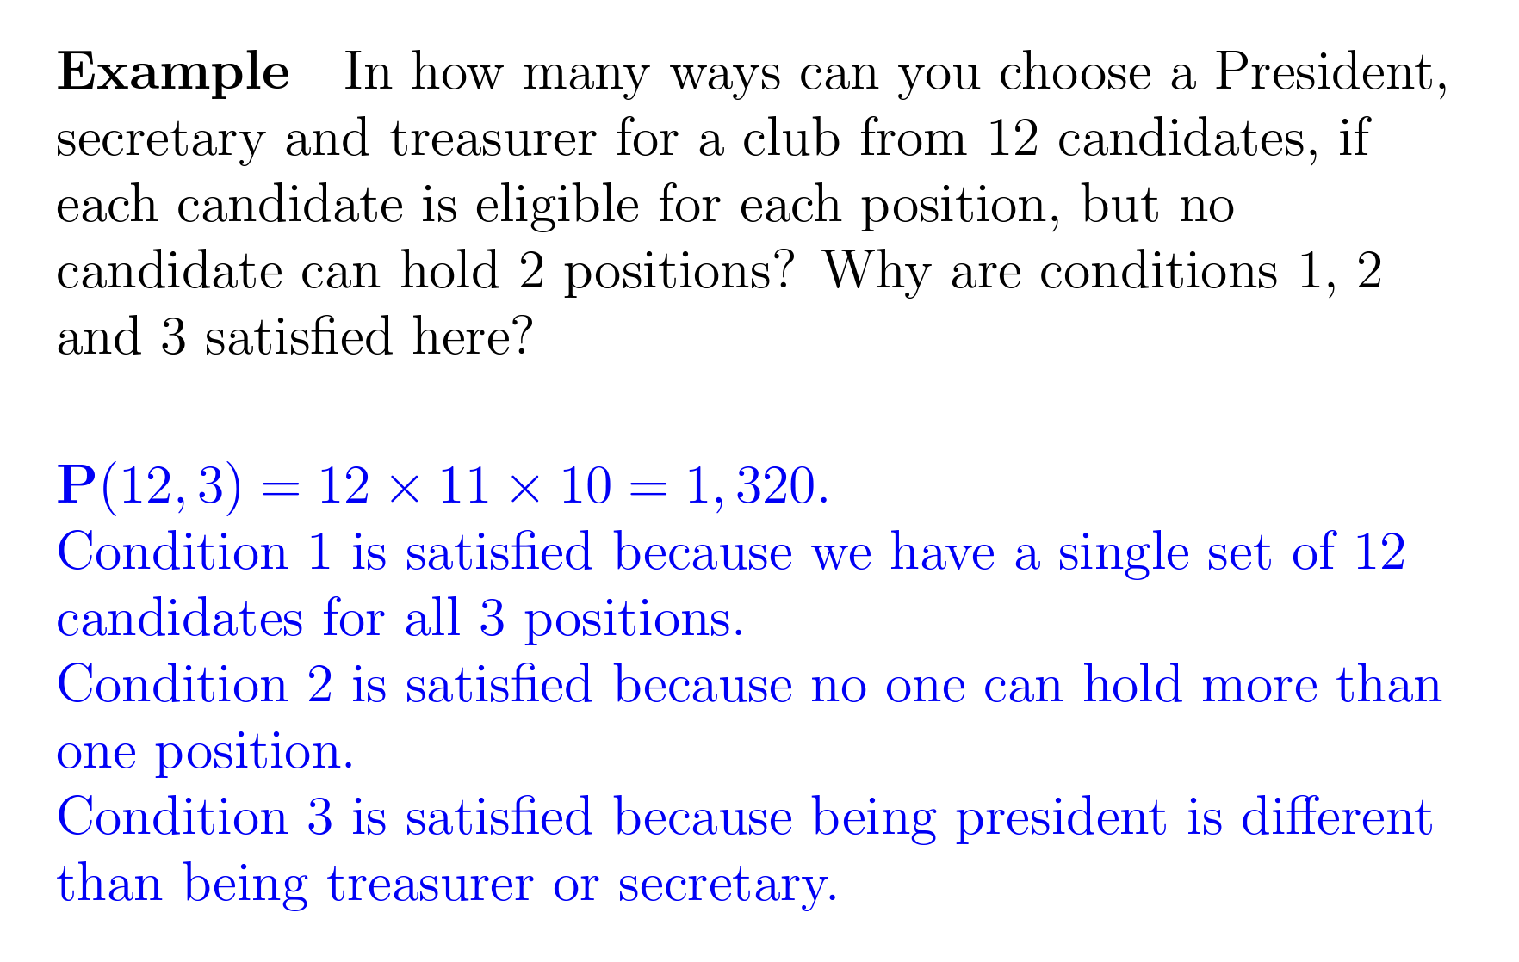
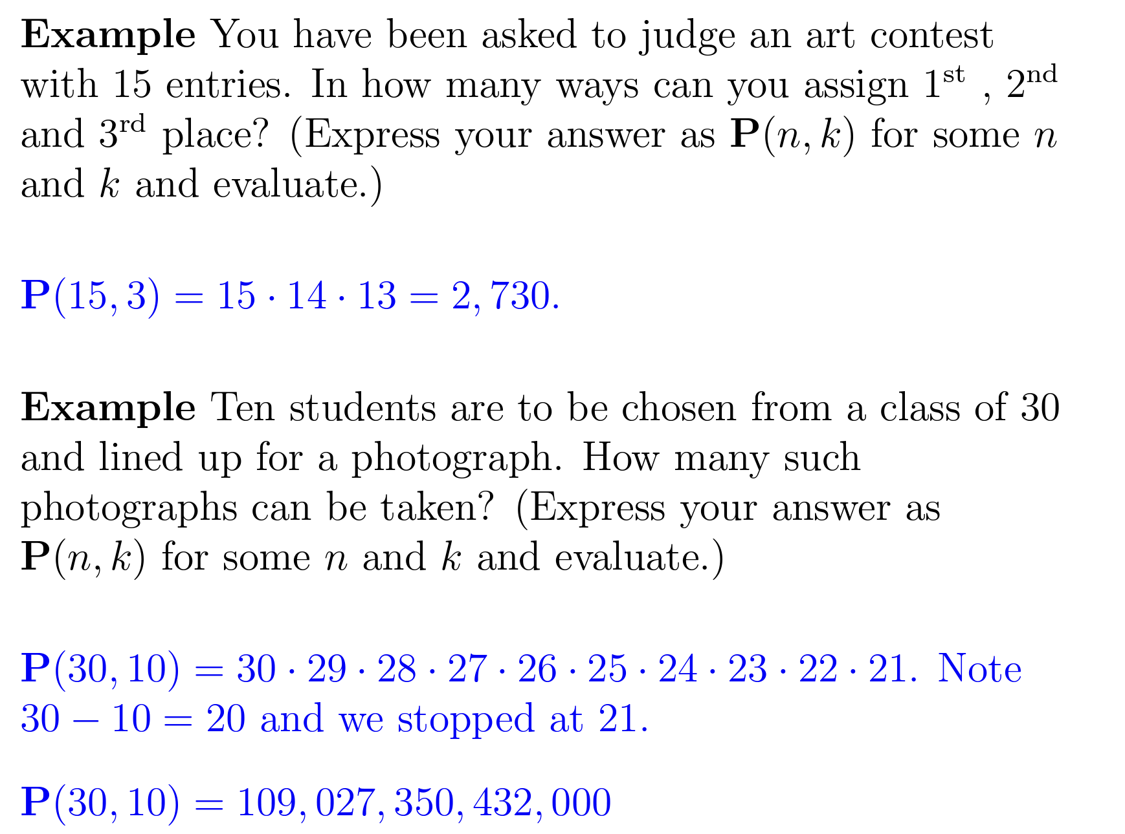
Permutations
Examples
Image credit - https://www3.nd.edu

Slide 12
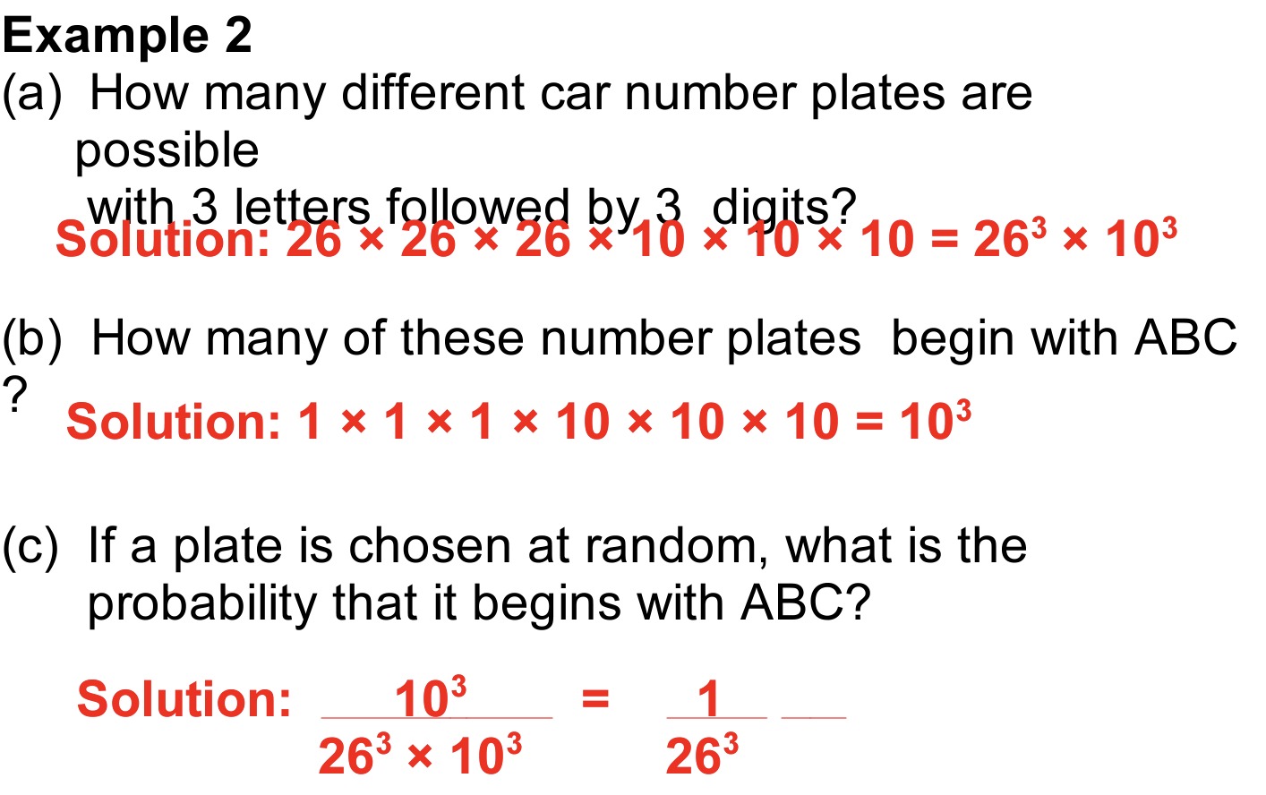
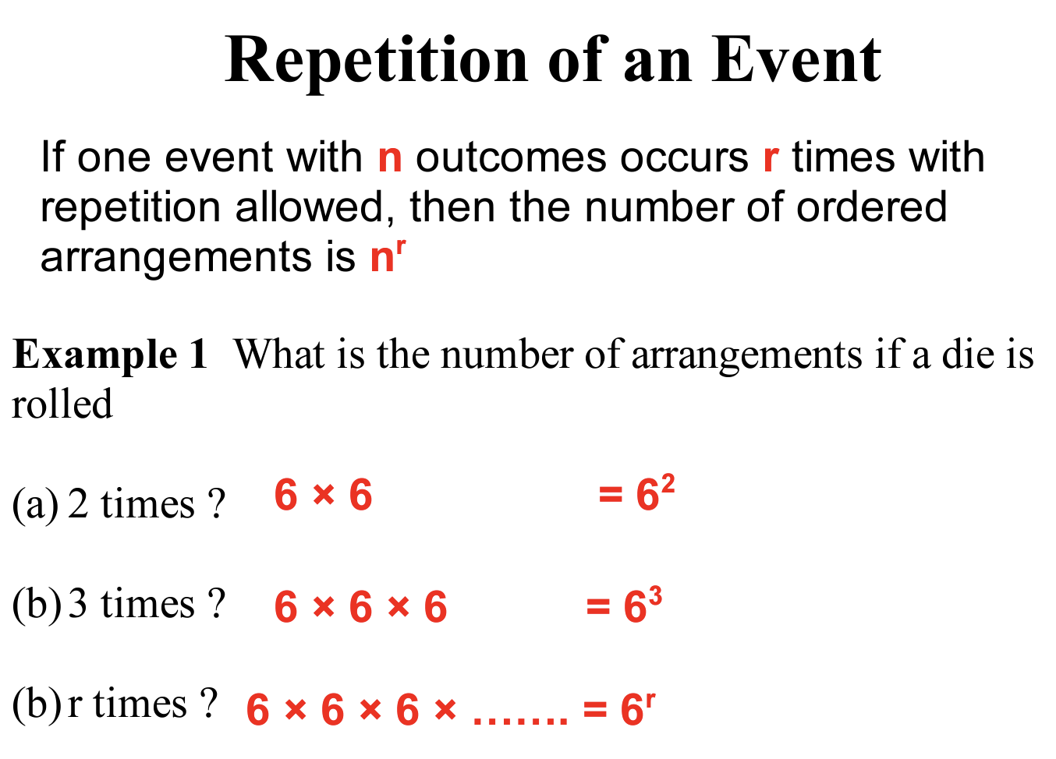
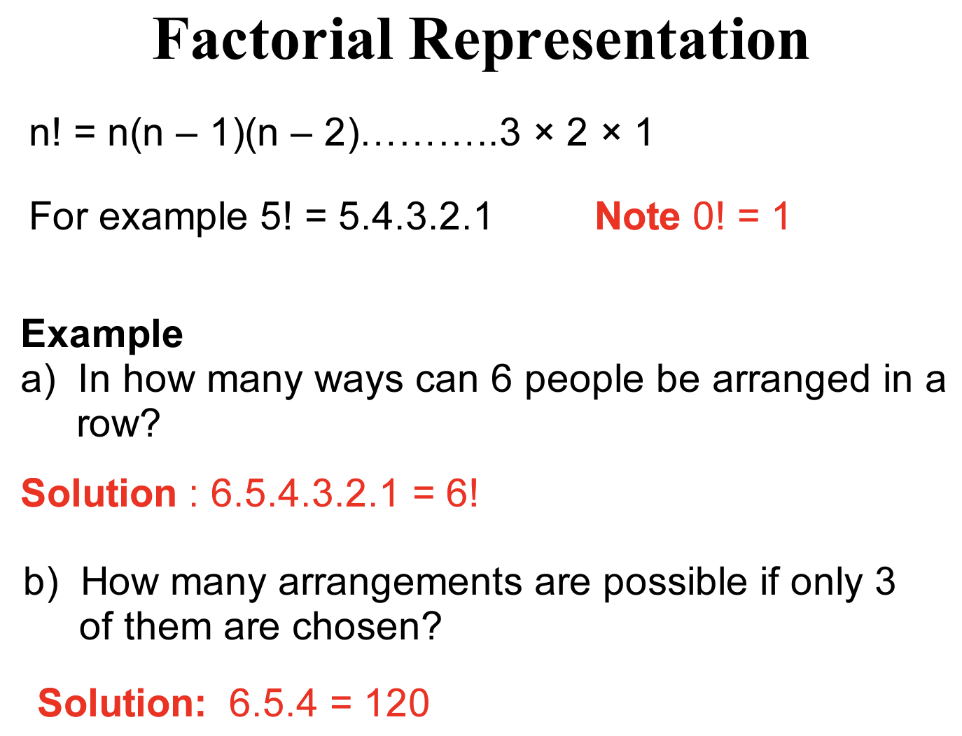
Permutations
With and Without Repetition
Image credit - https://documents.uow.edu.au

Slide 13
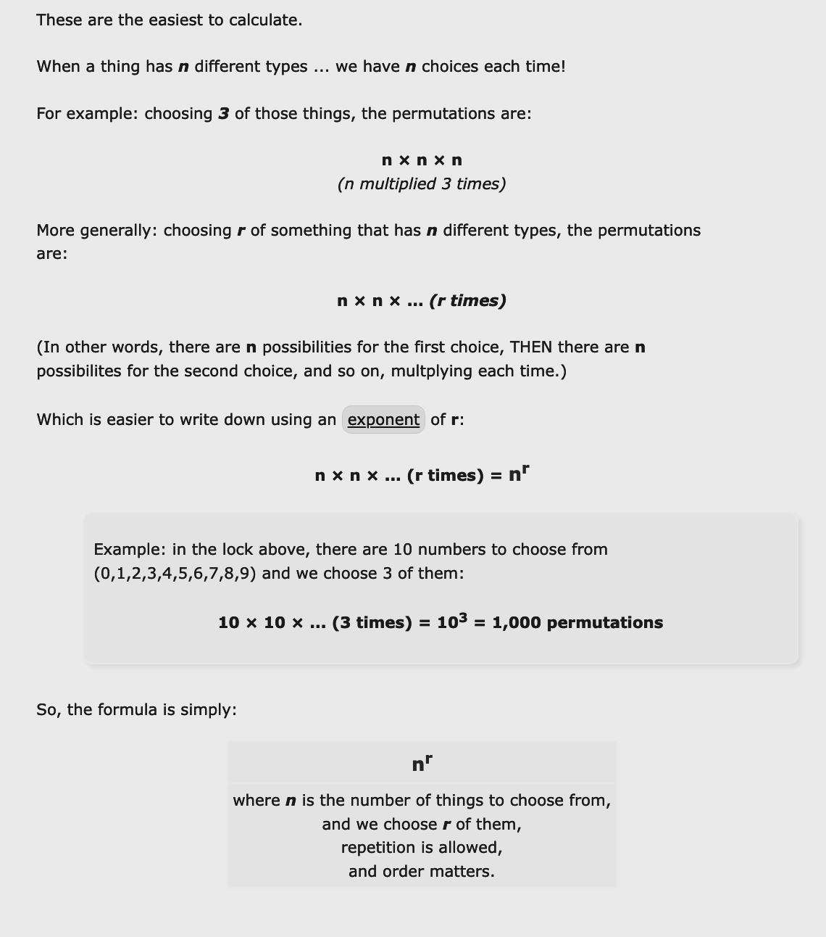
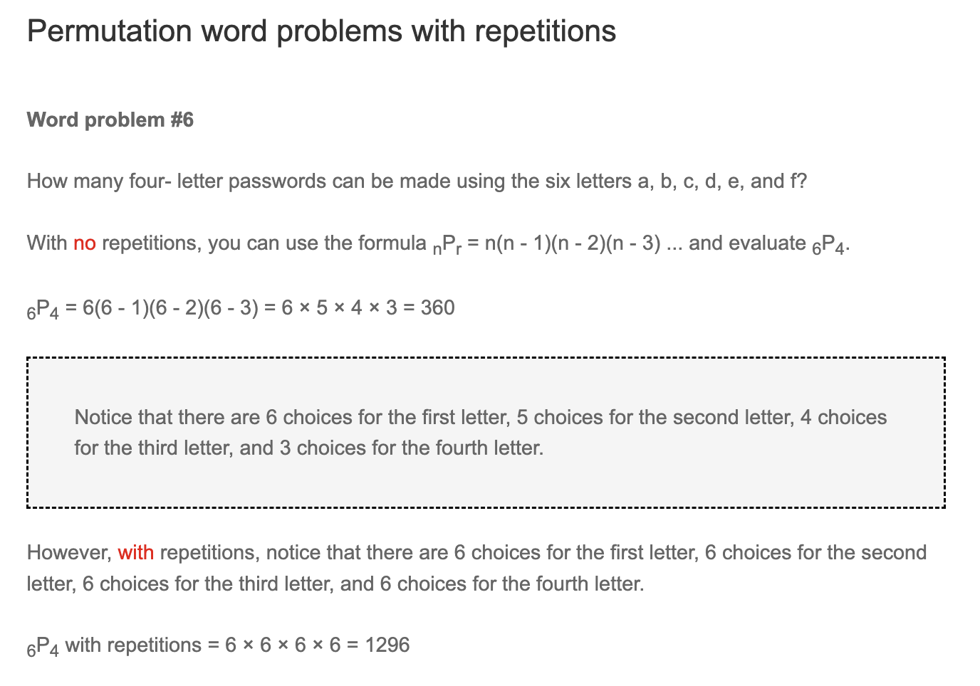
Permutations
With and Without Repetition
Image credit - https://www.basic-mathematics.com/
Image credit - https://www.mathsisfun.com/

Slide 14
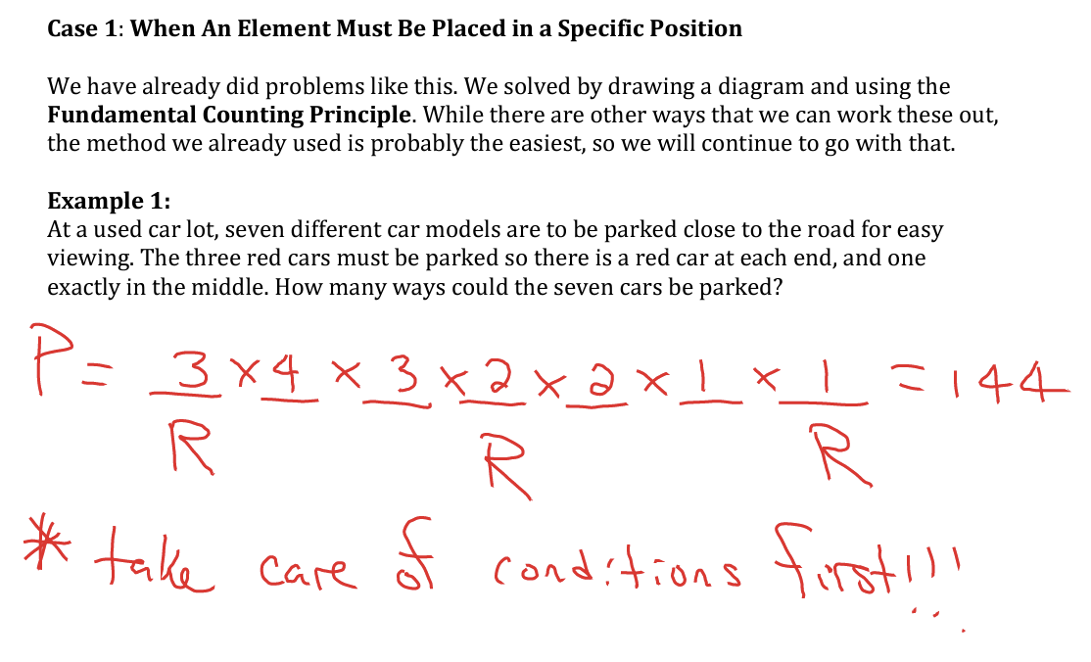
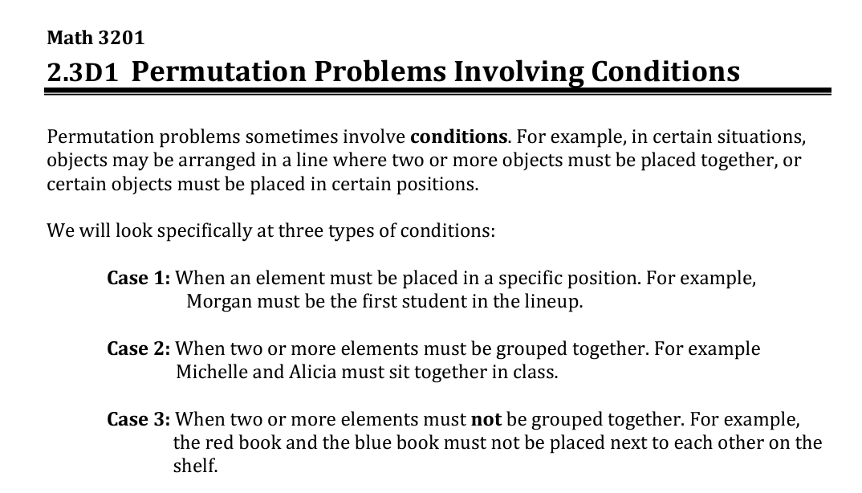
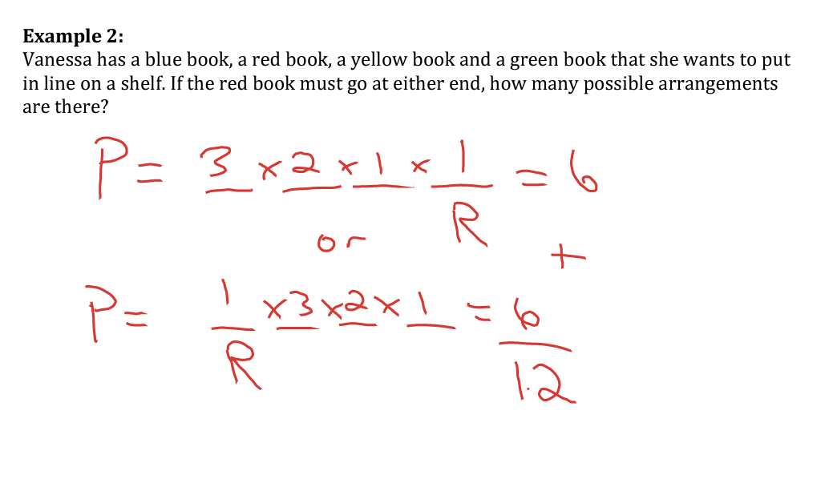
Permutations
Involving Conditions
Image credit - http://mrpaynemath.weebly.com

Slide 15
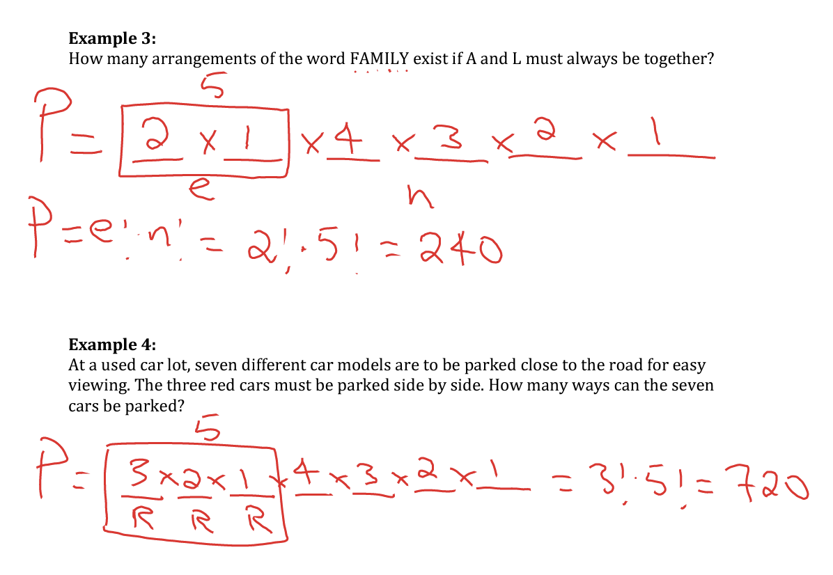
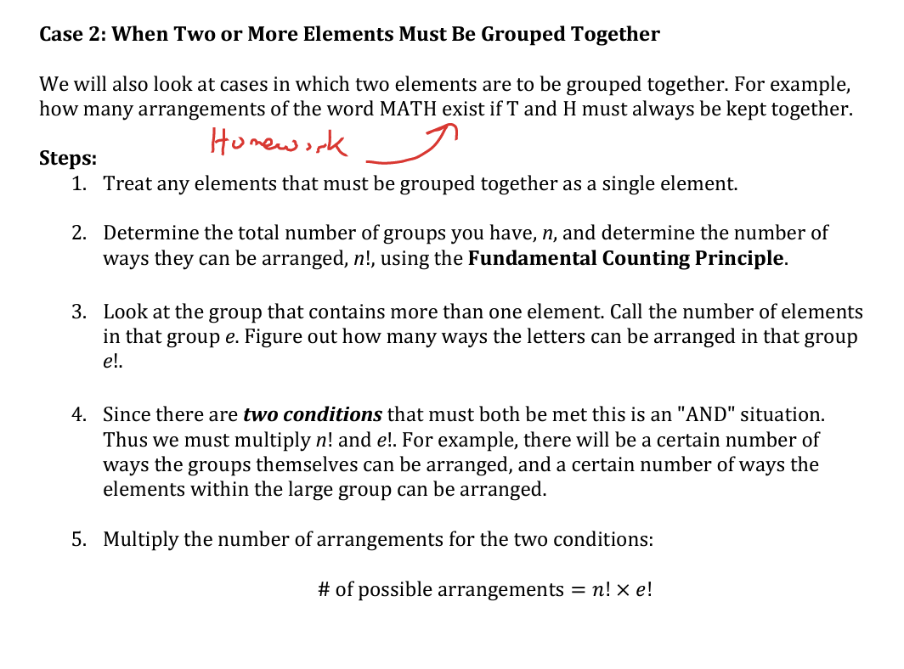
Permutations
Involving Conditions
Image credit - http://mrpaynemath.weebly.com

Slide 16
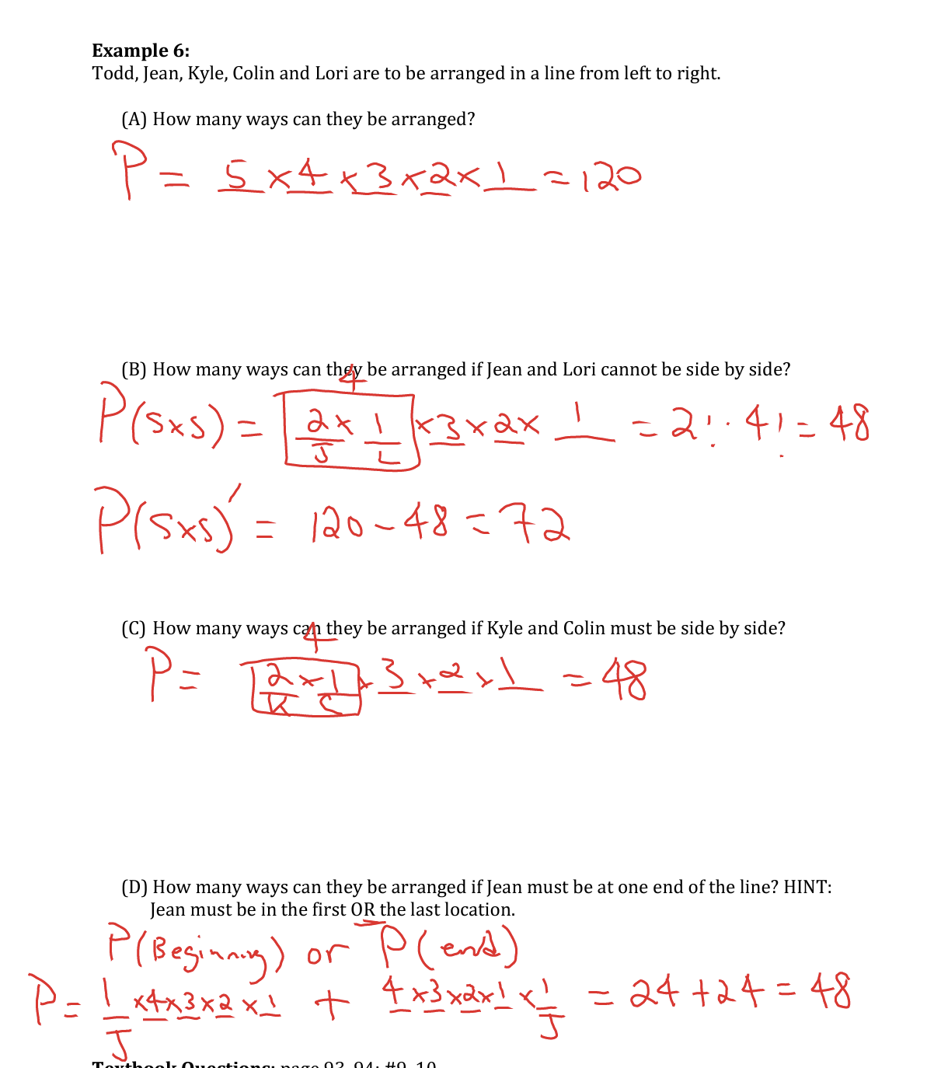
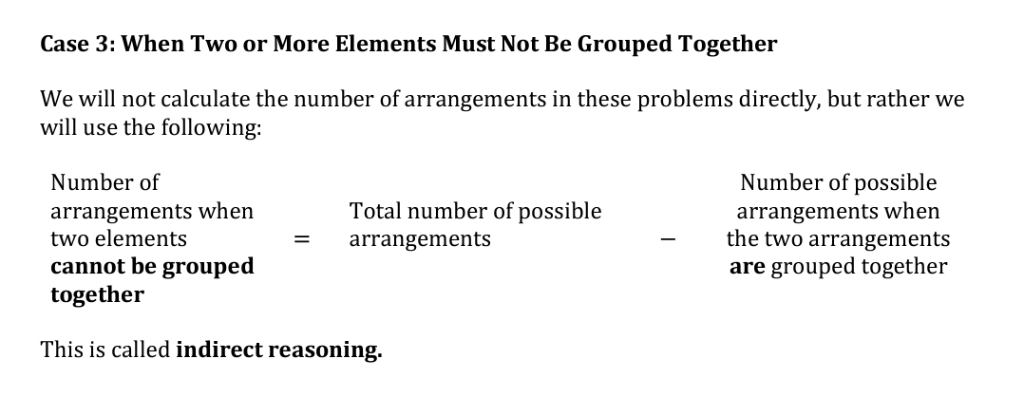
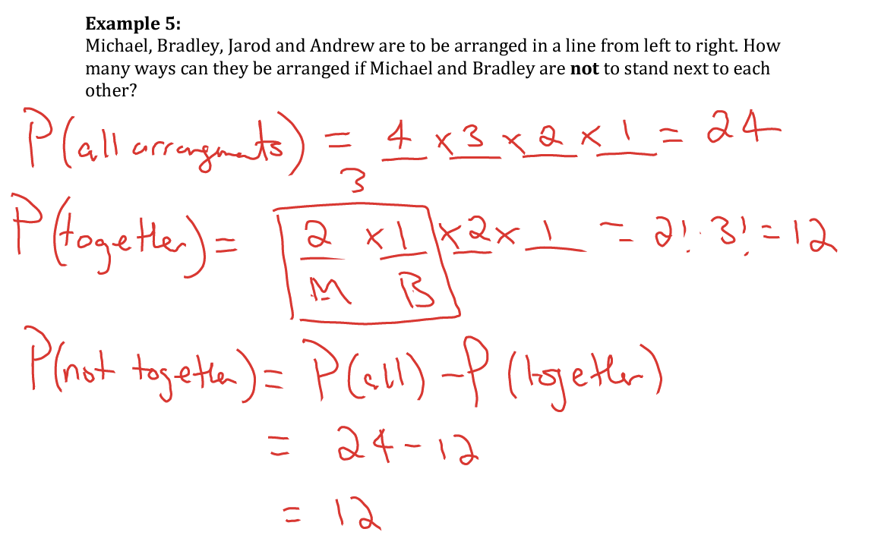
Permutations
Involving Conditions
Image credit - http://mrpaynemath.weebly.com

